Slide 1
Pitch Estimation
Prepared by
Tasnim Nishat Islam
170692
Codes available at : https://github.com/tasnimislam/1706092_dsp_projects.git

Slide 2
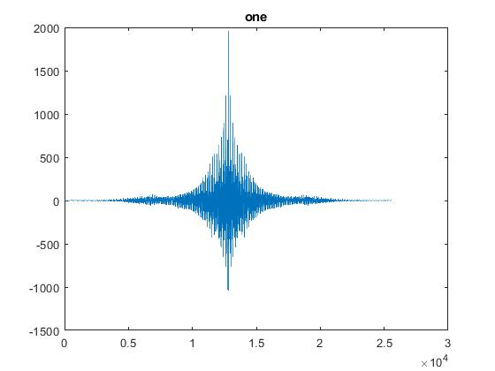
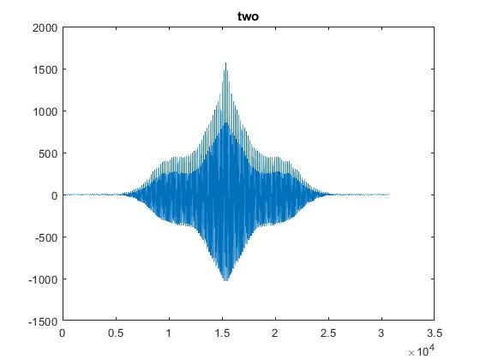
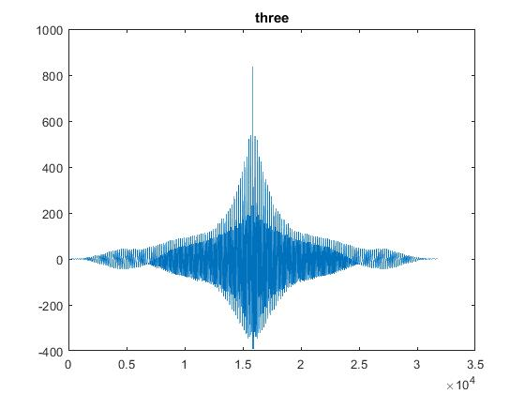
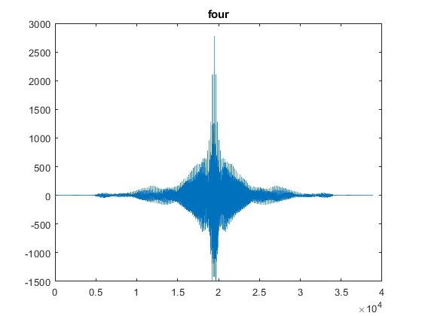
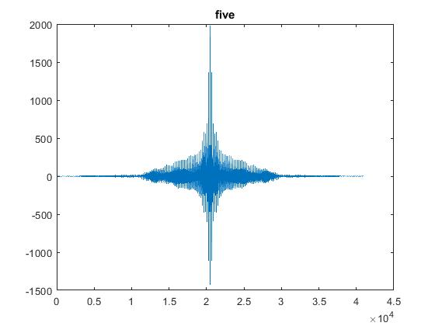
XCORR: Only the signals

Slide 3
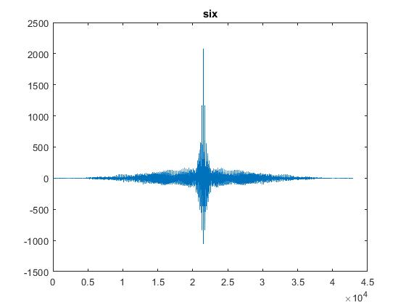
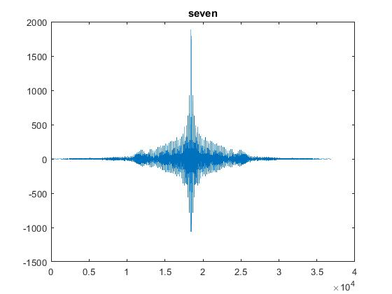
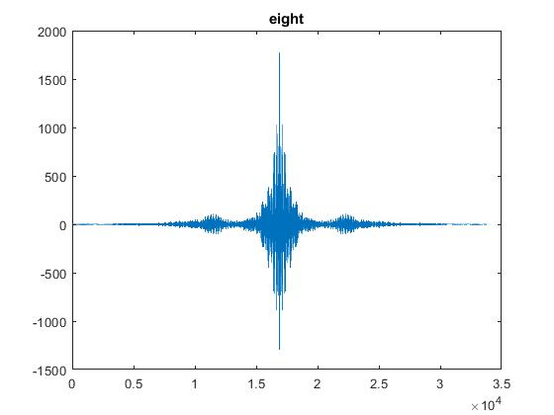
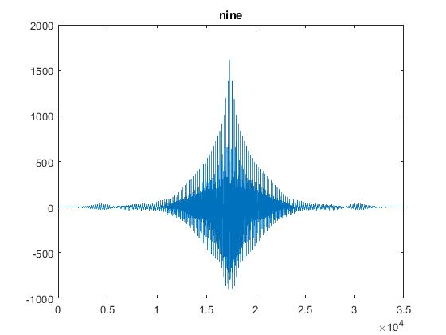
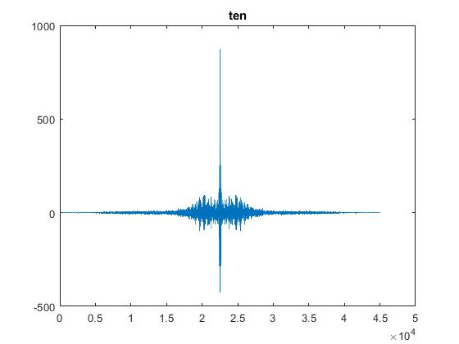
XCORR: Only the signals

Slide 4
Pitch estimation
Number | Pitch
One | 196
Two | 207
Three | 204
Four | 196
Five | 203
Six | 198
Seven | 206
Eight | 208
Nine | 206
Ten | 186

Slide 5
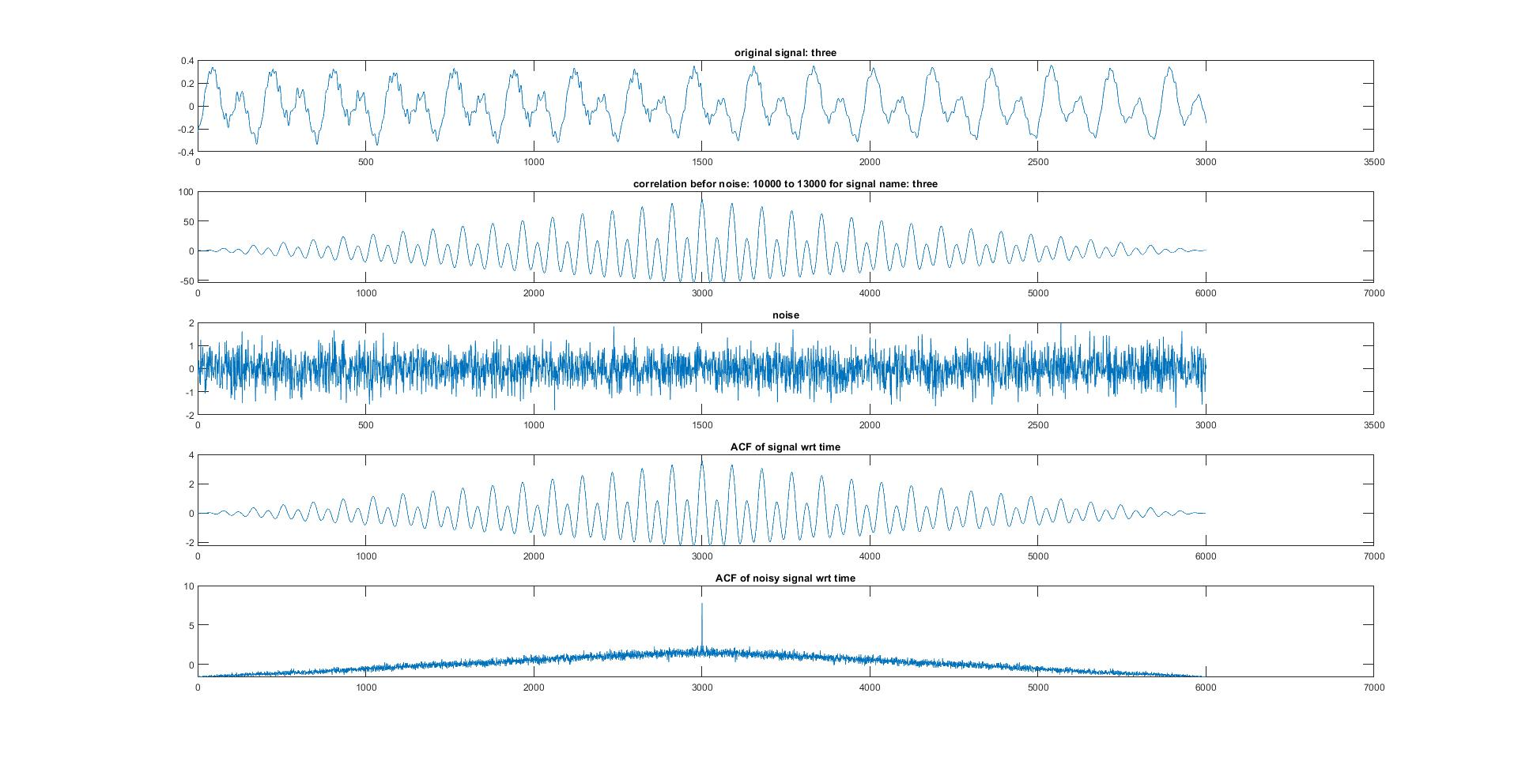
ACF plot for three

Slide 6
One.wav

